Slide 1

GPU-Accelerated DEM
Simulation of a Snowball
Avalanche Dynamics
on NVIDIA Maxwell
Maurizio Grisotto
Politecnico di Torino - GPU Programming 2025/2026
s336145@studenti.polito.it
Project: Angry Santa

Slide 2
Outline
Project Overview
Physics Model
System Architecture
CPU Implementations
GPU Optimizations
Experimental Setup
Results and Benchmarks
Conclusion and Future Work
GPU Programming: Angry Santa - Politecnico di Torino 2025/2026
1

Slide 3
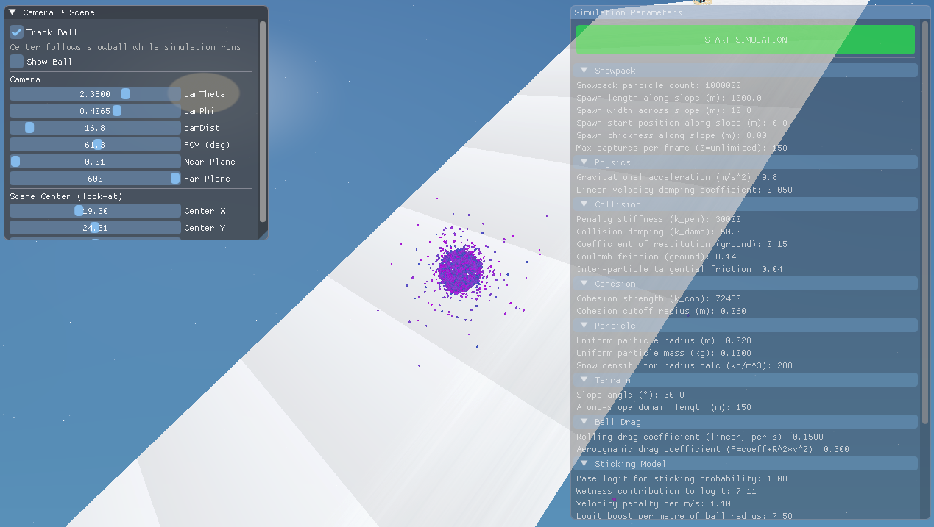
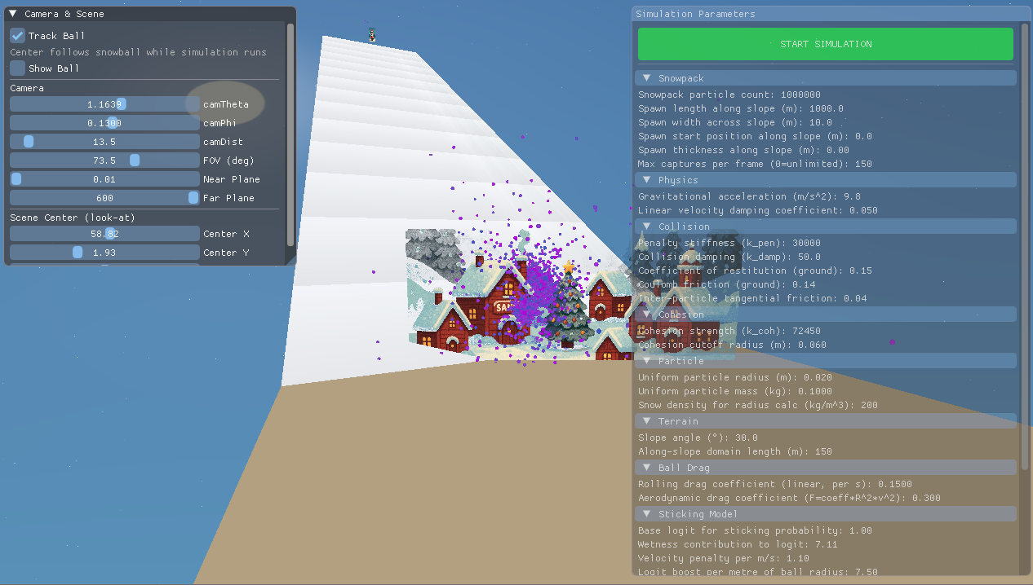
Project Overview
Introduction and Motivations
Explore the concepts of the course.
Simulation of a physical process - a snowball rolling down an inclined plane - as if it were a component of a real-time graphics engine for video games.
Humorous scenario: Santa Claus rolls a giant snowball down a slope, destroying the elves' village.
Rendering techniques using the Vulkan framework.
Working code for Intel (Windows OS) and ARM (Linux OS) platforms.
Experimenting with AI capabilities in a foreign domain
GPU Programming: Angry Santa - Politecnico di Torino 2025/2026
2
Notes:
The objective of this project is to explore the concepts presented in the GPU Programming course, including parallel programming, Flynn's taxonomy, the Maxwell GPU architecture, advanced CUDA programming techniques, GPU optimizations, the advantages and disadvantages of atomic operations, profiling, and the use of several GPU-related libraries.
To practice as many of these concepts as possible, a simulation of a physical process—a snowball rolling down an inclined plane—was implemented as if it were a component of a real-time graphics engine for video games. Since the course took place during the winter season, a humorous scenario was devised in which Santa Claus, tired and frustrated by his excessive workload, rolls a giant snowball down a slope, destroying the elves' village.
The project also covered rendering techniques using the Vulkan framework, resulting in a basic scene composed of a camera, geometric shapes, images, and textures.

Slide 4
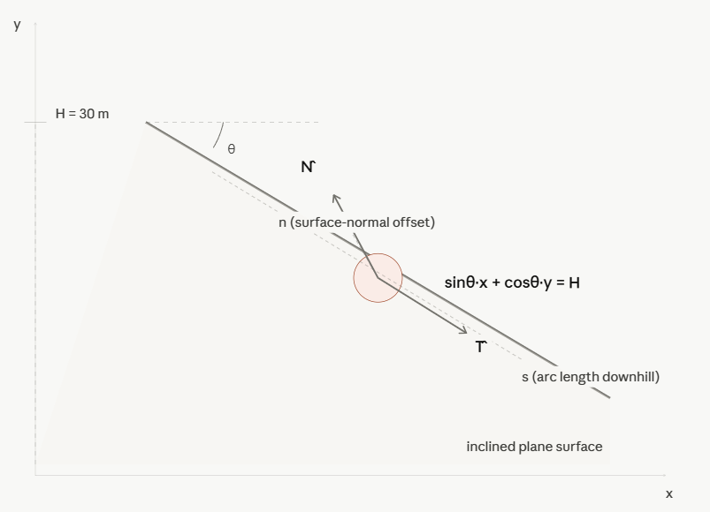

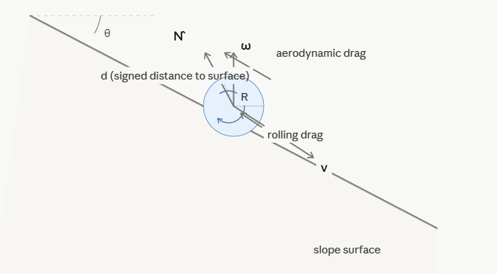
Cundall & Strack (1979): A discrete numerical model for granular assemblies
Pöschel & Schwager (2005): Computational Granular Dynamics
Physics Model
The (simplified) Discrete Element Method (DEM) with penalty-based contact and Coulomb friction without persistent contact history
Snowpack: N particles on a rectangular band with jitter
Infinite inclined plane: sin(θ)·x + cos(θ)·y = H
Curvilinear parameterization (s, n) mapping
Per-particle wetness w ∈ [w_min, w_max] via curand
Sorted once by posX → enables binary-search range limiting
Dynamic shell:
Growing particle system where actual interactions happen
Snowball core: rigid-body dynamics on slope
Rolling drag (linear) + aerodynamic drag (quadratic, ∝ R²)
Rolling-without-slip: ω = (1/R)·(N_slope × v)
Quaternion integration for orientation
GPU Programming: Angry Santa - Politecnico di Torino 2025/2026
3

Slide 5
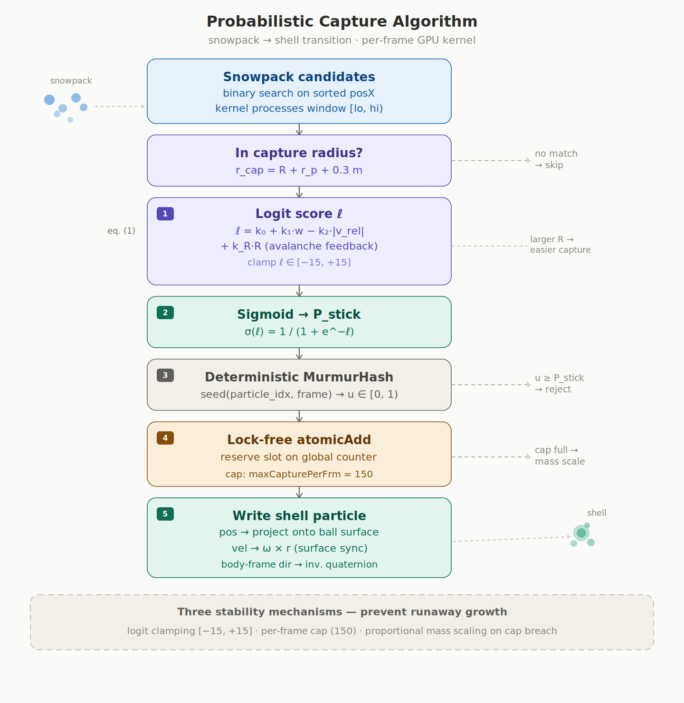
Cundall & Strack (1979): A discrete numerical model for granular assemblies
Pöschel & Schwager (2005): Computational Granular Dynamics
Physics Model
Probabilistic Capture Algorithm and Shell Forces
Capture converts snowpack → shell particles each frame:
Logit: ℓ = k₀ + k₁·w - k₂·|v_rel| + k_R·R (avalanche feedback)
Sigmoid probability: P_stick = σ(ℓ) = 1/(1+e^{-ℓ})
Deterministic murmurhash PRNG (no curand state overhead)
Lock-free atomicAdd for slot reservation
Shell particle forces:
Gravity + Mass-proportional damping
Tether spring-damper to ball surface anchor
DEM inter-particle contact with Coulomb friction
Stability: logit clamping, per-frame cap, proportional mass scaling
GPU Programming: Angry Santa - Politecnico di Torino 2025/2026
4

Slide 6
Physics Model
Default Values
Physics
gravity = 9.81f; // m/s² dt = 0.0033f; // timestep (s) damping = 0.05f; // mass-proportional velocity damping (k_d) stiffness = 30000.0f; // soft-sphere penalty stiffness (k_pen) collisionDamping = 50.0f; // collision damping (k_damp) cohesion = 72450.0f; // cohesion strength (k_coh) cohesionRadius = 0.06f; // cohesion cutoff (m) particleRadius = 0.02f; // uniform radius (m) particleMass = 0.1f; // per-particle mass (kg) restitution = 0.15f; // ground bounce factor (e) friction = 0.14f; // ground Coulomb friction (μ_ground) particleFriction = 0.04f; // inter-particle friction (μ_p) snowDensity = 200.0f; // kg/m³
Slope
slopeAngleDeg = 30.0f; slopeHeight = 30.0f; // plane offset (m) domainLength = 150.0f; // max along-slope travel
Capture / Sticking
stickK0 = 1.0f; // base logit → ~73% at v=0, w=1 stickK1 = 7.11f; // wetness boost in logit stickK2 = 1.1f; // velocity penalty (per m/s of |v_rel|) stickRadiusBoost = 7.5f; // avalanche feedback (logit boost per metre of ball radius) logitClamp = 15.0f; // max absolute logit value for sigmoid stability maxCapturePerFrm = 150; // max particles captured per frame (growth rate limiter) wetnessMin = 0.0f; // min initial wetness [0,1] wetnessMax = 1.0f; // max initial wetness [0,1]
8.1.4. Shell
shellTetherK = 2717.0f; // tether spring stiffness (N/m)
shellTetherDamp = 50.0f; // tether damping coefficient
Shell capacity starts at 256 and grows dynamically (doubles) as particles are captured.
8.1.5. Snowpack Geometry
numParticles = 1000000; // total snowpack particle count
spawnLengthS = 1000.0f; // patch along slope (m)
spawnWidthZ = 10.0f; // patch lateral width (m)
spawnStartS = 0.0f; // start offset along slope (m)
spawnThicknessN = 0.0f; // 0 = single layer on surface
8.1.6. Rigid-Body Drag
rollingDrag = 0.15f; // rolling friction (linear drag coefficient)
aeroCoeff = 0.3f; // aerodynamic drag coefficient (quadratic, scales with R²)
8.1.7. Spatial Grid
cellSize = 4 * particleRadius; // = 0.08 m (default)
The grid uses a compact hash table: hashTableSize = nextPowerOf2(shellCapacity × 8), clamped to [4096, numCells]. This avoids allocating the full grid (~9.8M cells → ~75 MB) and instead uses ~32K entries (~256 KB) with prime-number spatial hashing (Teschner et al., 2003).
All parameters can be overridden via CLI flags (run with --help for the full list).
8.1.8. Performance / Profiling
traceInterval = 0; // frames between trace snapshots (0 to disable)
logInterval = 0; // frames between log outputs (0 = no log)
GPU Programming: Angry Santa - Politecnico di Torino 2025/2026
5

Slide 7
Physics Model
Default Values
Shell
shellTetherK = 2717.0f; // tether spring stiffness (N/m) shellTetherDamp = 50.0f; // tether damping coefficient
Snowpack Geometry
numParticles = 1000000; // total snowpack particle count spawnLengthS = 1000.0f; // patch along slope (m) spawnWidthZ = 10.0f; // patch lateral width (m) spawnStartS = 0.0f; // start offset along slope (m) spawnThicknessN = 0.0f; // 0 = single layer on surface
Rigid-Body Drag
rollingDrag = 0.15f; // rolling friction (linear drag coefficient) aeroCoeff = 0.3f; // aerodynamic drag coefficient (quadratic, scales with R²)
Spatial Grid
cellSize = 4 * particleRadius; // = 0.08 m (default)
Performance / Profiling
traceInterval = 0; // frames between trace snapshots (0 to disable) logInterval = 0; // frames between log outputs (0 = no log)
GPU Programming: Angry Santa - Politecnico di Torino 2025/2026
6

Slide 8
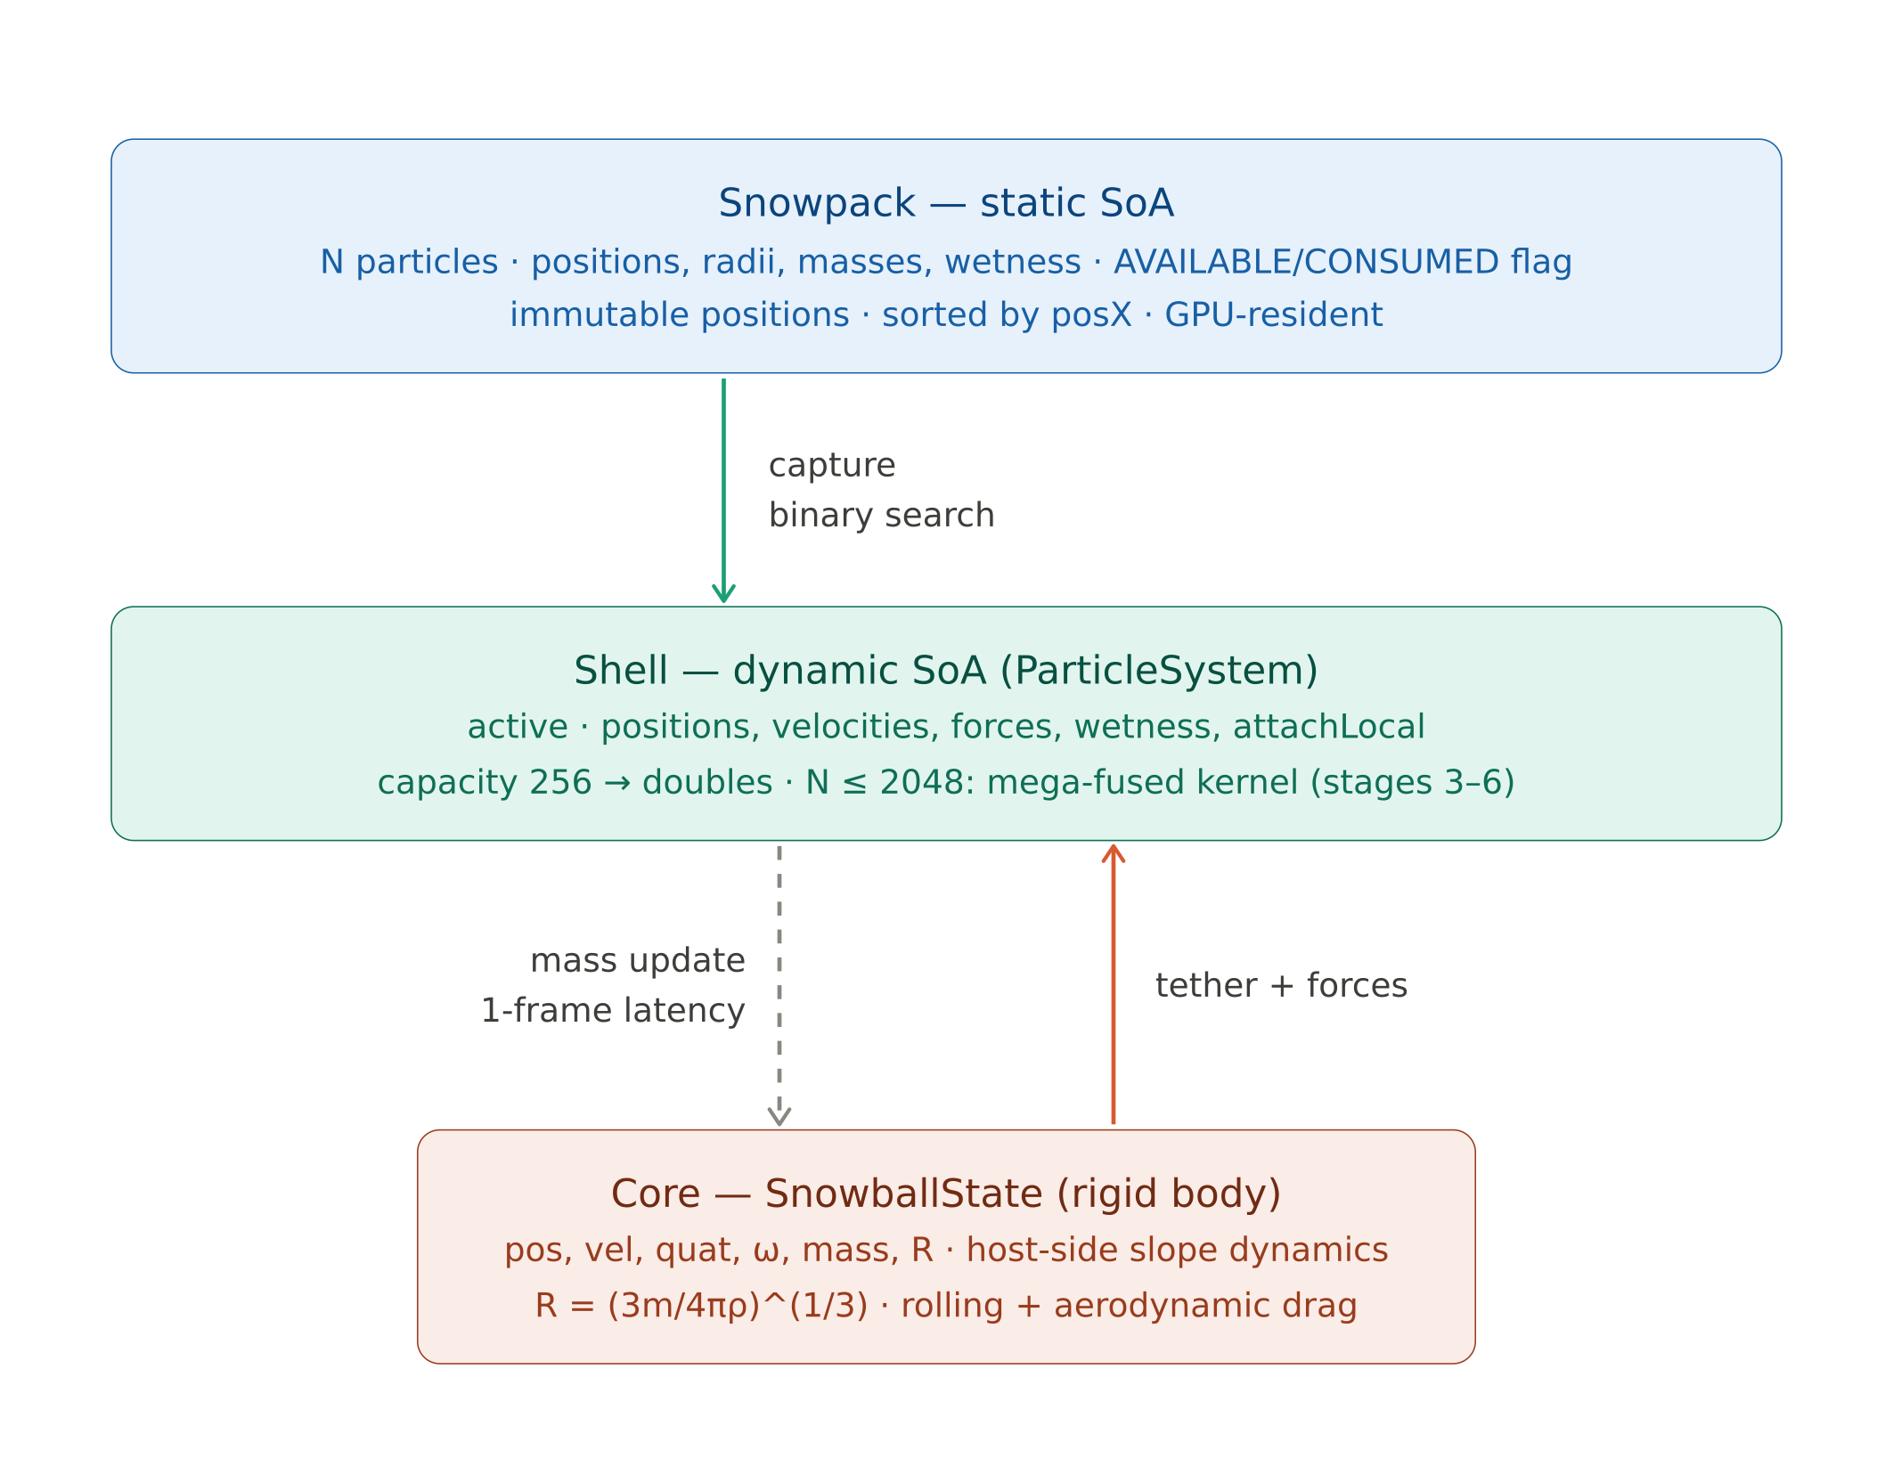
System Architecture
Three-Tier Particle Design
Deferred capture readback: 1-frame latency (pinned host memory)
GPU Programming: Angry Santa - Politecnico di Torino 2025/2026
7

Slide 9
CPU Implementations
Flynn’s Taxonomy
SISD Baseline:
Compiled with -O0 / /Od - no inlining, no vectorization
Strict performance floor for speedup measurements
SIMD + OpenMP optimized:
SSE2 (x86-64) / NEON (ARM64) - 4 particles per SIMD lane
16-byte aligned SoA arrays (aligned_malloc)
OpenMP: #pragma omp parallel
O(N²) brute-force collision (no spatial hashing)
GPU Programming: Angry Santa - Politecnico di Torino 2025/2026
8

Slide 10
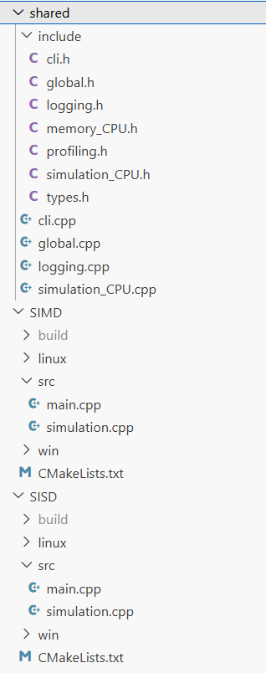
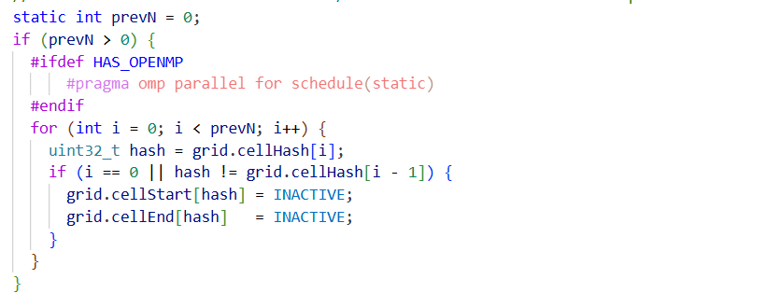
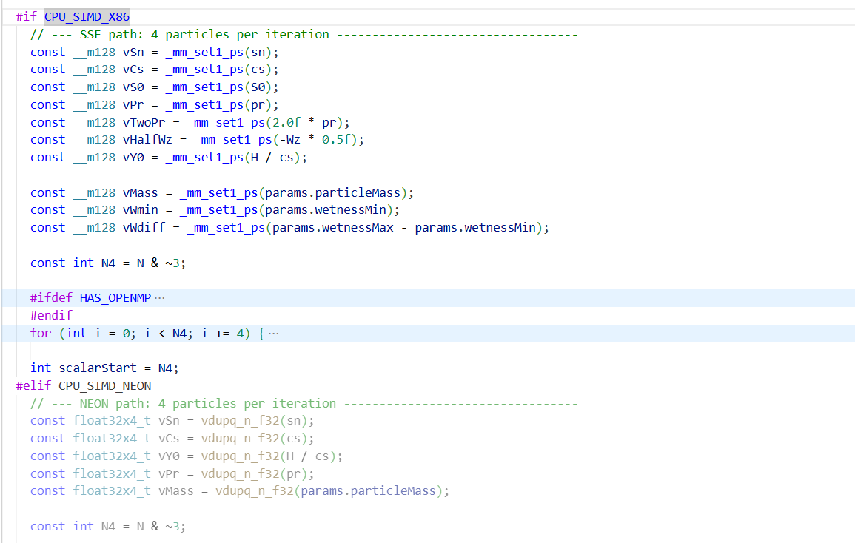
CPU Implementations
GPU Programming: Angry Santa - Politecnico di Torino 2025/2026
9

Slide 11
GPU Optimizations
Memory System
SoA Layout: 100% coalesced 128-byte transactions per warp
AoS would waste up to 90% of bus bandwidth
Constant Memory: SimParams (~152 B) broadcast to all warps in ~5 cycles
__ldg() / __restrict__: routes loads through read-only texture cache
Doubles effective cache bandwidth without conflicts
Pinned Memory: eliminates 30–40 ms GPU stalls from pageable memcpy
Capture count + mass packed into single 8-byte buffer
Unity Build (coding): single translation unit shares __constant__ across kernels
GPU Programming: Angry Santa - Politecnico di Torino 2025/2026
10

Slide 12
Memory Hierarchy
Every level of the hierarchy is explicitly exploited
Every level of the hierarchy is explicitly exploited
Level | Usage | Size/Capacity
Registers | Local vars, force accumulators | 24–48 / thread
__constant__ | SimParams (broadcast) | ~152 B
Shared Memory | Warp-cooperative tile | 12.4 KB/block
Read-only Cache | __ldg() loads (immutable SoA) | HW-managed
L2 Cache | Particle working set | 1 MB / 256 KB
Global (GDDR5) | SoA arrays | 16N × 4 B
GPU Programming: Angry Santa - Politecnico di Torino 2025/2026
11

Slide 13
GPU Optimizations
Compute and ALU
Warp-Cooperative Shared-Memory Tiling:
Each warp loads 32-neighbor tile into shared memory
[MAX_WARPS][WARP_SIZE+1] padding avoids bank conflicts
__syncwarp() instead of __syncthreads() (avoids deadlock)
Non-symmetric collision: zero atomics, all forces in registers
Trades 2× FLOPs for zero contention (net win on Maxwell)
Single precision + --use_fast_math (FP64:FP32 = 1:32 on Maxwell)
ALU tricks: rsqrtf pattern, branchless clamping (FMNMX),
murmurhash PRNG, quaternion Rodrigues (15 FMA vs 27 matmul)
GPU Programming: Angry Santa - Politecnico di Torino 2025/2026
12

Slide 14
Simon Green (2010): Particle Simulation using CUDA
GPU Optimizations
Spatial Hashing - Multi-Stream
Spatial Hashing and Uniform Grid: O(N²) → O(N·k) collision detection
Prime hash: (cx·73856093) ⊕ (cy·19349663) ⊕ (cz·83492791)
Compact table: nextPowerOf2(N×8) → ~256 KB vs ~75 MB full domain
CUB DeviceRadixSort with bit-count limiting
Cell Boundaries: Index pointers store the start and end of each cell to quickly locate neighboring particles
Interaction Kernel: One thread per particle evaluates physical contact forces within neighboring cells
Multi-Stream Pipeline:
simStream + gridStream + traceStream (async D2H)
Gated Event Recording: only every 64 frames (saves ~110–165 μs)
GPU Programming: Angry Santa - Politecnico di Torino 2025/2026
13
Notes:
Green proposes dividing the three-dimensional simulation space into a regular grid of cubic cells (Uniform Grid), where the side length of each cell equals the maximum particle interaction diameter. This ensures a particle can only interact with elements inside its own cell or within the 26 adjacent cells.

Slide 15
GPU Pipeline
Adaptive Dual-Path Execution
Small-N path (N ≤ 2048): single mega-fused kernel
Replaces stages 3–6 in one GPU launch
Reduces GPU commands from ~10 to 1 per frame
Forces never transit global memory — stay in registers
Large-N path (N > 2048): 7-stage multi-stream pipeline
Capture → Core update → Forces+Tether → Grid build → Collision → Integrate → Core RB
Forces+Tether ∥ Grid build (concurrent on simStream / gridStream)
Fork/join via cudaEventDisableTiming events
Threshold N=2048 chosen empirically:
Below: launch overhead > brute-force O(N²) cost
Above: grid-based O(N·k) justifies build overhead
GPU Programming: Angry Santa - Politecnico di Torino 2025/2026
14

Slide 16
GPU Pipeline Large-N Stages
Multi-Stream Fork/Join Architecture
Multi-Stream Fork/Join Architecture
# | Stage | Kernel | Stream | Block
1 | Particles Capture | captureFromSnowpack | sim | 256
2 | Core update | host code | — | —
3 | Forces + Tether | forceTether | sim | 256
4 | Grid build | hash→sort→ranges | grid | 256
5 | Collision | neighborCollision | sim | 512
6 | Integrate + Ground | integrateGround | sim | 256
7 | Core Rigid Body | host code | — | —
GPU Programming: Angry Santa - Politecnico di Torino 2025/2026
15

Slide 17
GPU Pipeline Small-N Stages
Kernel Fusion Architecture
# | Stage | Kernel | Stream | Block
1 | Particles Capture | captureFromSnowpack | sim | 256
2 | Core update | host code | — | —
3 – 4 – 5 - 6 | Fusion | shellPhysicsFused | sim | 256
7 | Core Rigid Body | host code | — | —
GPU Programming: Angry Santa - Politecnico di Torino 2025/2026
16

Slide 18
Experimental Setup
Experimental Setup
Two Maxwell-class test platforms
Two Maxwell-class test platforms
Spec | Laptop (GTX 960M) | Jetson Nano
CPU | Intel i7-6700HQ | ARM Cortex-A57
CPU Cores/Threads | 4 / 8 | 4 / 4
GPU | GeForce GTX 960M | Tegra X1
Compute Capability | SM 5.0 | SM 5.3
SMs | 5 | 1
CUDA Cores | 640 | 128
L2 Cache | 1 MB | 256 KB
Memory BW | ~30 GB/s (GDDR5) | ~25.6 GB/s (LPDDR4)
GPU Programming: Angry Santa - Politecnico di Torino 2025/2026
17

Slide 19
Results - GTX 960M
Per-Kernel Timing at N = 100K (Fused Regime)
At N=10⁵, GPU consistently yields lower FPS than CPU baselines
Shell never exceeds ~2,048 particles → single thread-block
Only 1 of 5 SMs utilized → 80% of GPU idle
Fixed costs (launch, sync, PCIe) = 35–50% of frame time
CPU advantage: deep OoO pipeline, large L3 cache keeps all data in cache
SIMD: 4-wide AVX vectorization → peak 11,174 FPS
Key insight: GPU parallelism only pays off once workload amortizes launch and transfer overheads and if is sufficient «big»
Crossover: between N=100K and N=500K on this platform
GPU Programming: Angry Santa - Politecnico di Torino 2025/2026
18

Slide 20
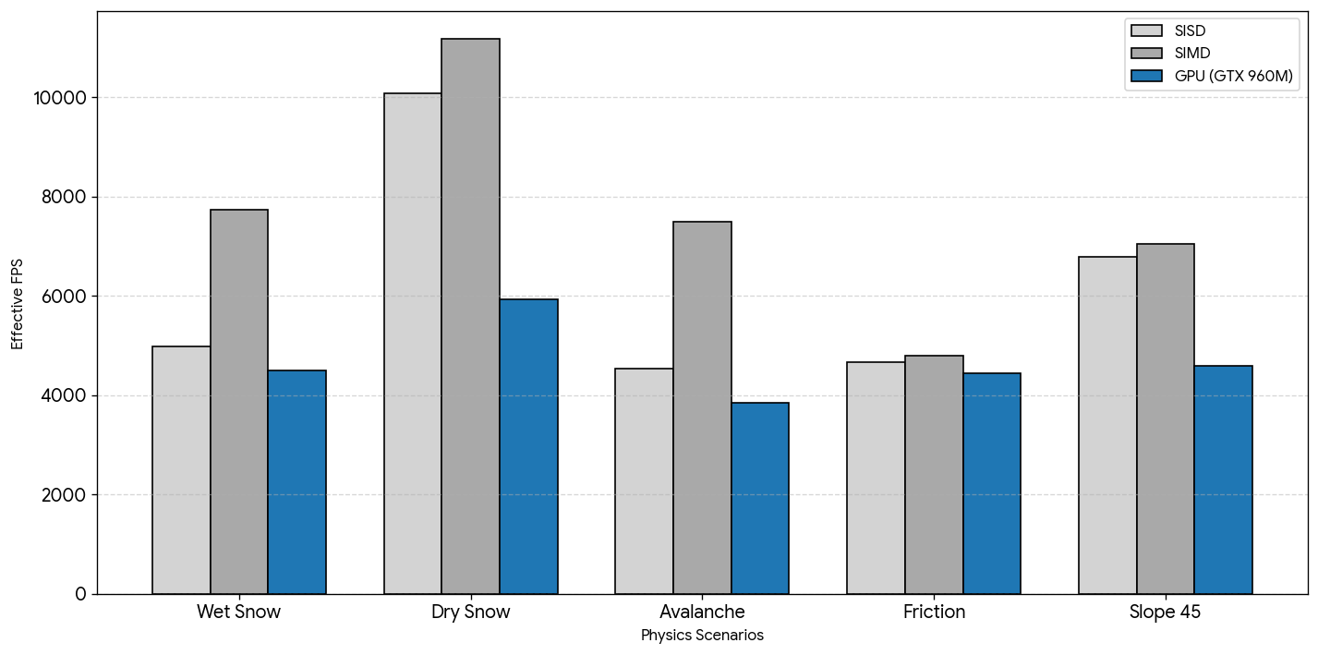
Results - GTX 960M Scenarios N=10⁵
GPU parallelism only pays off once workload amortizes launch and transfer overheads and if is sufficient “big”
GPU Programming: Angry Santa - Politecnico di Torino 2025/2026
19

Slide 21
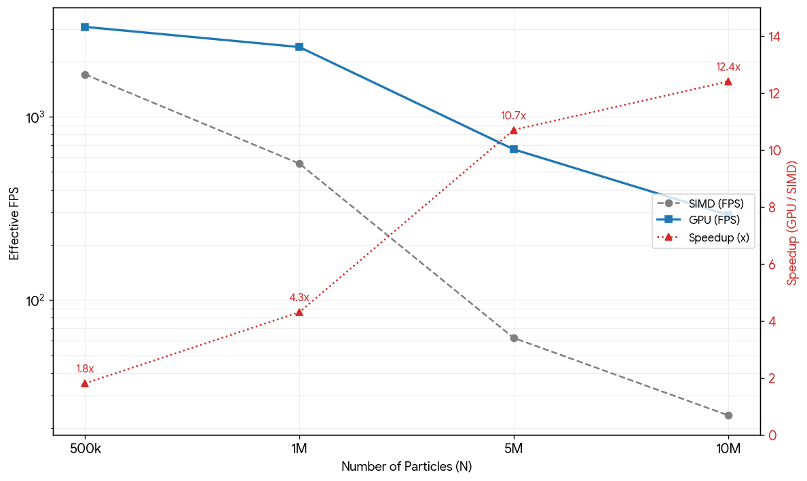
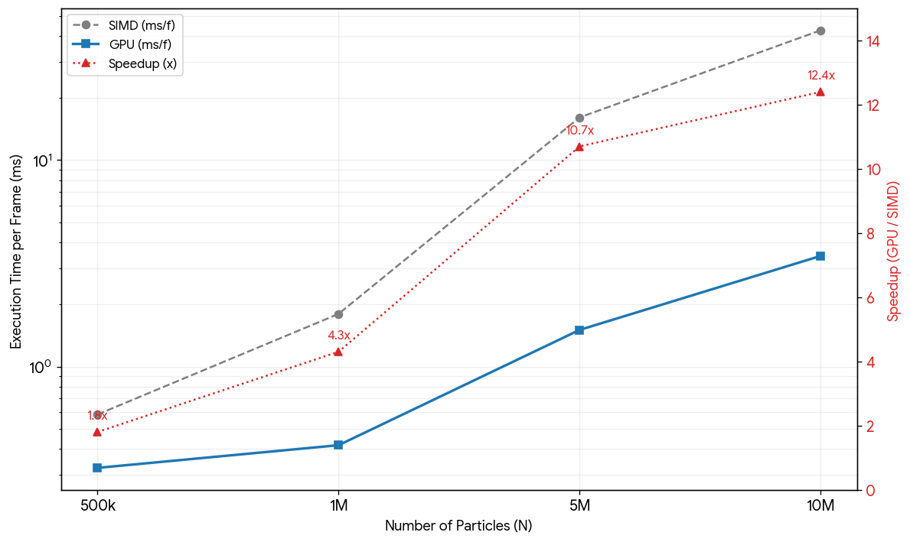
Results - GTX 960M Scaling
GPU vs SIMD CPU - Speedup grows with particle count
N | SIMD (FPS) | GPU (FPS) | SIMD (ms/f) | GPU (ms/f) | Speedup
500K | 1,706.6 | 3,097.8 | 0.586 | 0.323 | 1.8×
1M | 555.8 | 2,404.5 | 1.799 | 0.416 | 4.3×
5M | 62.1 | 664.7 | 16.10 | 1.505 | 10.7×
10M | 23.5 | 291.1 | 42.55 | 3.435 | 12.4×
→ 12.4× speedup at N=10M: GPU's O(N·k) grid-based collision scales far better than CPU's O(N²)
→ Overhead never exceeds 3% of frame time at large scale
GPU Programming: Angry Santa - Politecnico di Torino 2025/2026
20

Slide 22
Results - Jetson Nano
Unified Memory: GPU Wins at Small N
At N=10⁵: GPU slightly outperforms CPU in all scenarios (vs GTX result)
Unified memory eliminates PCIe transfer overhead entirely
Kernel launch overhead: only 11–18% of frame time (vs 35–50% on GTX)
Scaling bottleneck at large N:
Single SM (128 cores, max 2048 threads) → serializes collision
N=5M: collision kernel 174.9 ms (GPU) vs 37.0 ms (4-core SIMD CPU)
GPU speedup inverts: 0.3× at N=5M
GPU Programming: Angry Santa - Politecnico di Torino 2025/2026
21

Slide 23
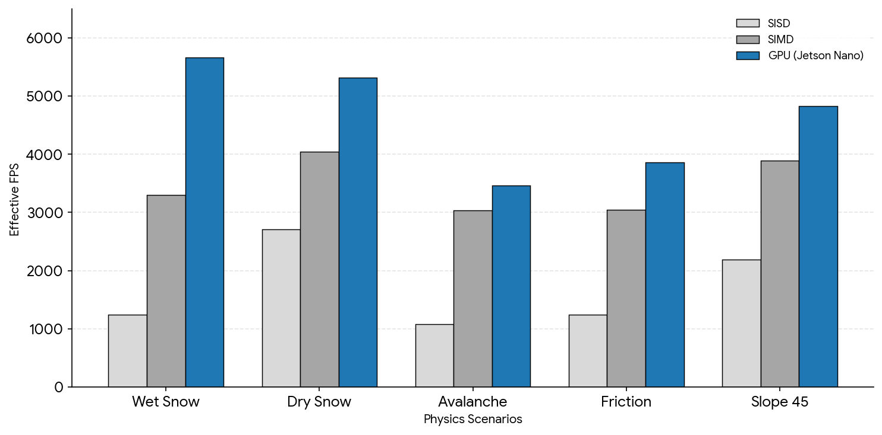
Results - Jetson Nano Scenarios N=10⁵
Unified Memory: GPU Wins at Small N
GPU Programming: Angry Santa - Politecnico di Torino 2025/2026
22

Slide 24
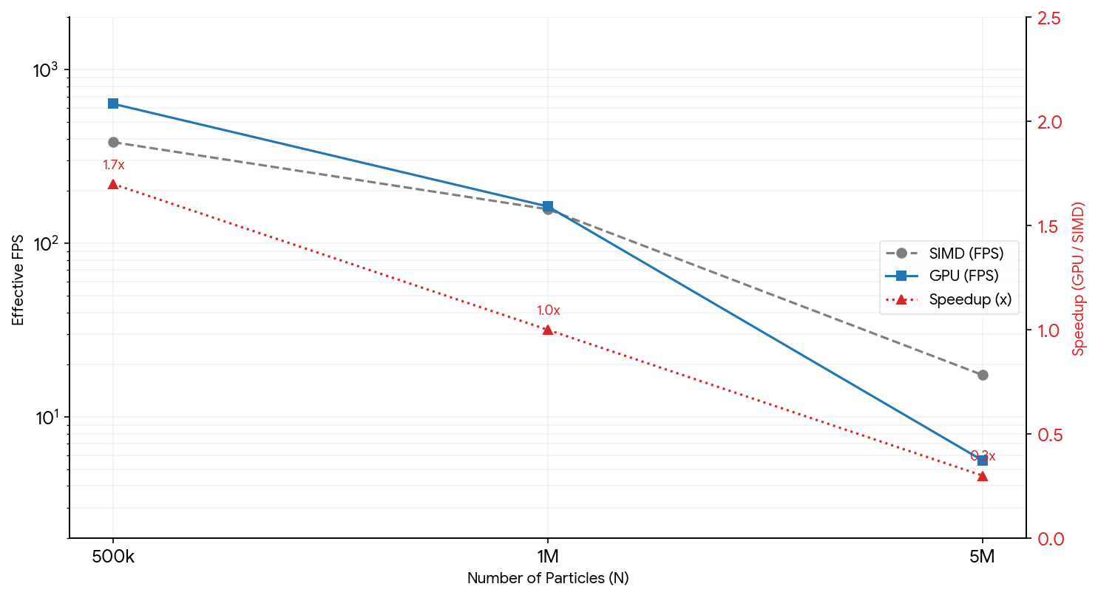
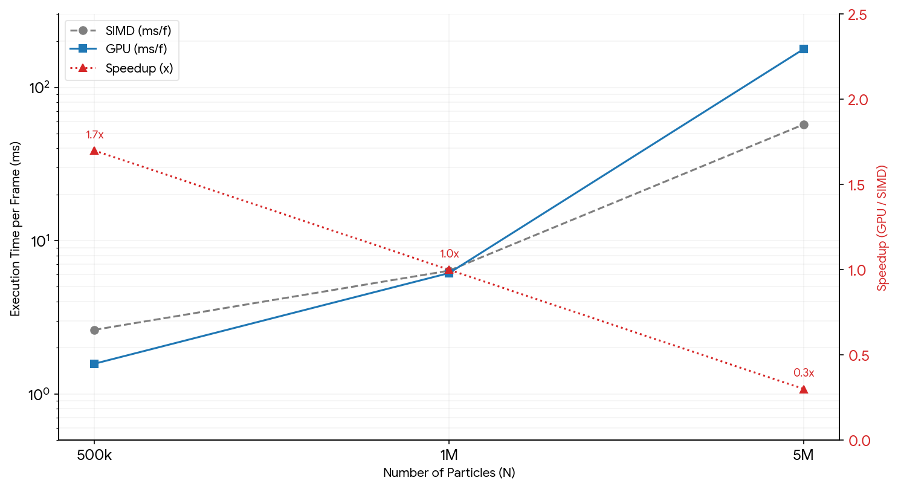
Results - Jetson Nano Scaling
Single SM bottleneck at large N
Single SM bottleneck at large N
N | SIMD (FPS) | GPU (FPS) | SIMD (ms/f) | GPU (ms/f) | Speedup
500K | 382.0 | 635.4 | 2.618 | 1.574 | 1.7×
1M | 156.9 | 162.8 | 6.372 | 6.144 | 1.0×
5M | 17.4 | 5.6 | 57.31 | 177.95 | 0.3×
10M | — | — | — | — | OOM
Key insight: multi-SM GPUs (GTX 960M with 5 SMs) mitigate single-SM saturation at large N
GPU Programming: Angry Santa - Politecnico di Torino 2025/2026
23

Slide 25
Final Key Findings
Performance Analysis Summary
GTX 960M (5 SMs):
CPU wins at N ≤ 100K (launch overhead dominates)
GPU crossover at N ~ 500K → reaches 12.4× at N=10M
Grid-based O(N·k) collision is the key scalability enabler
Jetson Nano (1 SM):
GPU wins at small N (no PCIe overhead)
Single SM saturates at N ≥ 1M → CPU catches up and overtakes
Both platforms:
Overhead (launch, sync, transfers) < 3% at scale
Mega-fused kernel essential for small-N performance
Architecture-aware tuning >> generic optimization
GPU Programming: Angry Santa - Politecnico di Torino 2025/2026
24

Slide 26
Conclusion
Key Takeaways
Architecture-aware optimization matters
Every register, KB of shared memory, and kernel launch is measurable
Warp-cooperative tiling, zero-spill allocation, gated events
→ all responses to specific Maxwell bottlenecks
Adaptive fusion pays off
Mega-fused (N≤2048) → seamless transition to grid-based (N>2048)
Eliminates launch overhead during initial growth phase
Zero spill > 100% occupancy
62.5–75% occupancy acceptable to avoid DRAM spill (~300 cycles)
Better real-world performance than forcing higher occupancy
GPU Programming: Angry Santa - Politecnico di Torino 2025/2026
25

Slide 27
Future Work
Extensions and Improvements
Multi-GPU / Domain Decomposition
Partition spatial grid across GPUs via halo exchange
Theoretical analysis discussed in the paper attachment
Persistent-Contact DEM
Track tangential spring history across frames
More accurate friction modelling (additional per-pair state)
3D Terrain
Height-map or mesh-based terrain for realistic mountain geometry
Volta+ Optimizations (SM 7.0+)
Hardware atomicAdd(float) → symmetric collision viable again
Cooperative groups replace warp-level synchronization
GPU Programming: Angry Santa - Politecnico di Torino 2025/2026
26

Slide 28
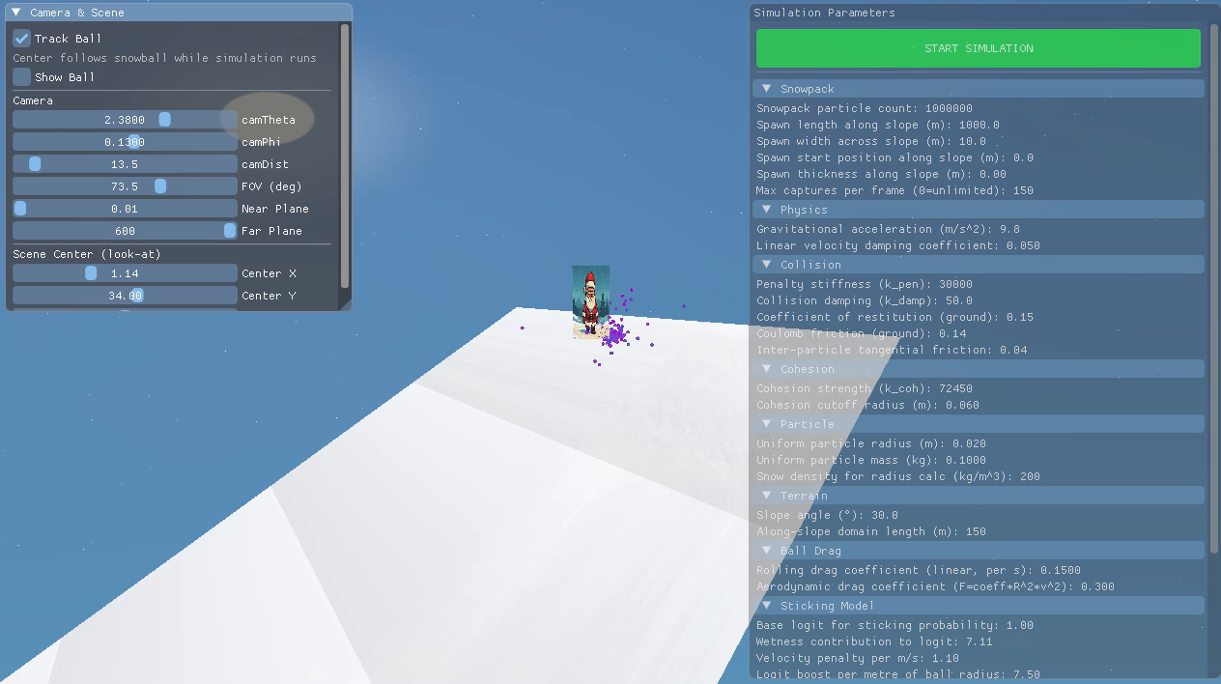
Video
GPU Programming: Angry Santa - Politecnico di Torino 2025/2026
27

Slide 29

Thank You
Questions?
Code: github.com/politos336145/GPU-Programming-2025-2026
Contact: s336145@studenti.polito.it
GPU Programming: Angry Santa - Politecnico di Torino 2025/2026

